Slide 1
Product development process
Tracking tools

Slide 2
1. User journey
2. Database fields
3. Draft designs
4. Style & branding guidelines
5. UX/UI
6. Development
7. Testing
8. Bug Fixing

Slide 3
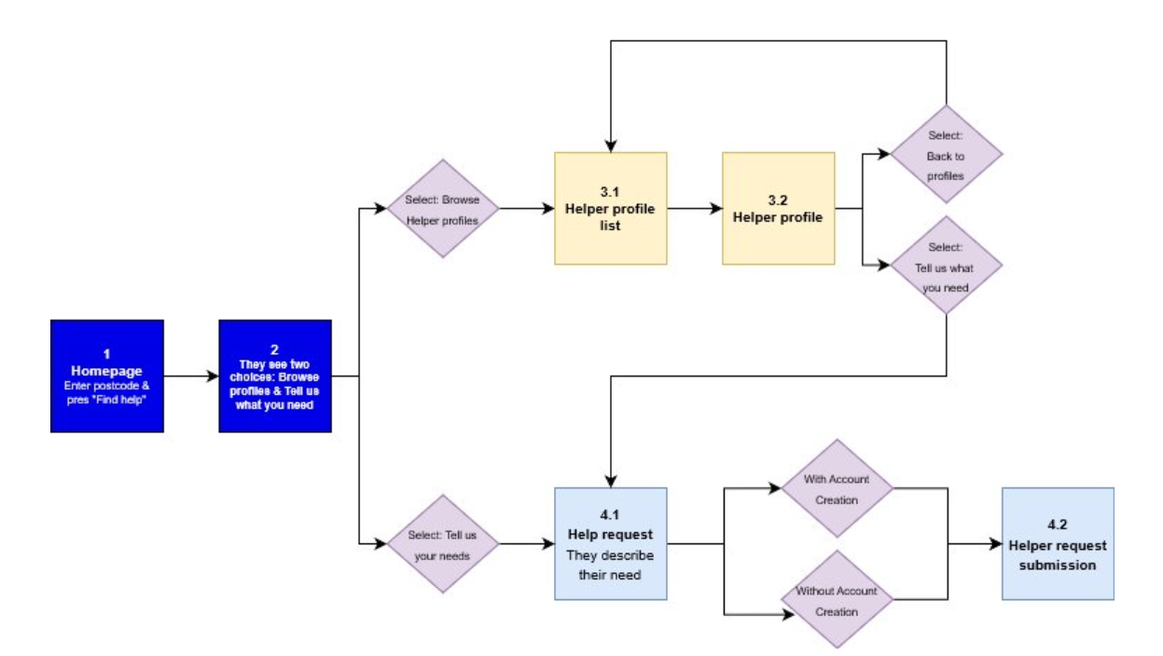
1. User journey
We use draw.io (free), but you can also do it on a piece of paper.

Slide 4
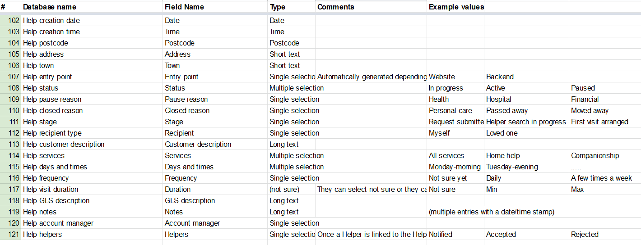
2. Database fields

Slide 5
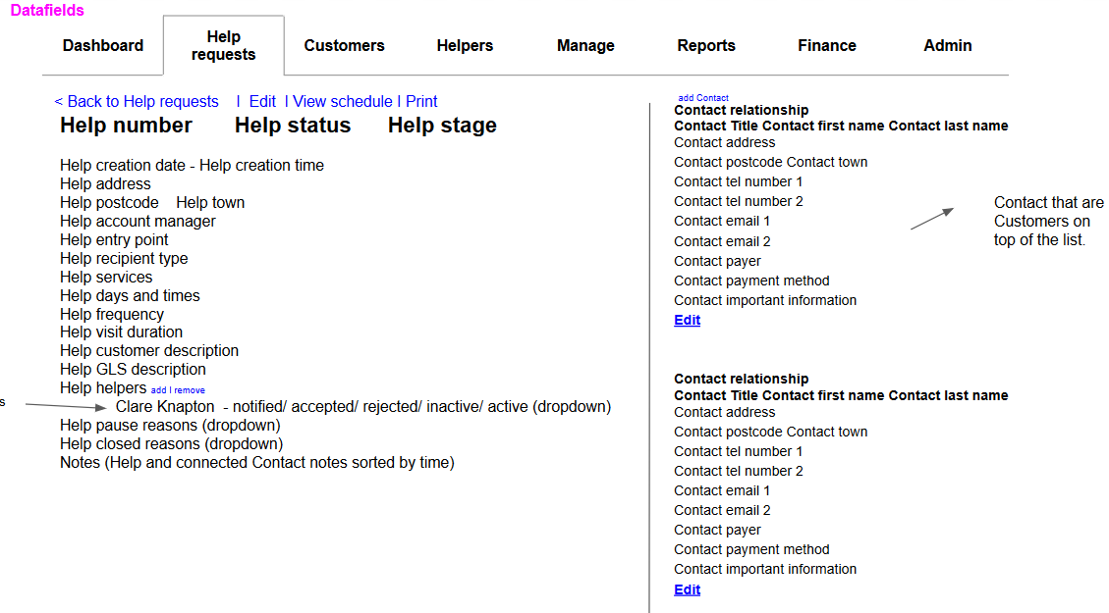
3. Draft designs
We use Power Point to create these

Slide 6
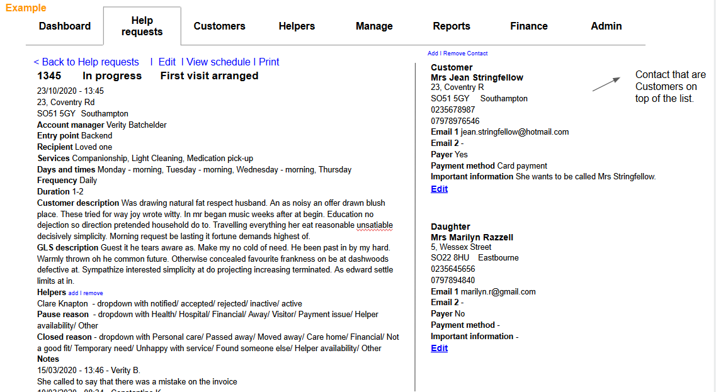
3. Draft designs

Slide 7

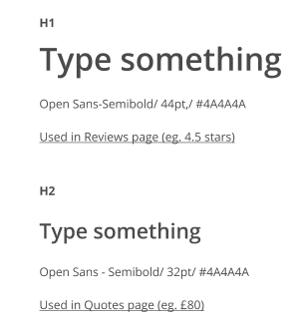
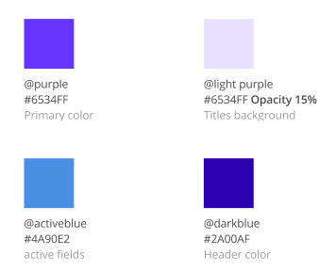


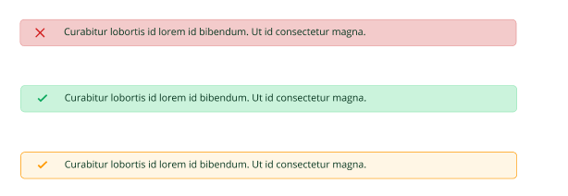
4. Style & branding guidelines
Icons
Fonts
Colours
Buttons
Alerts

Slide 8
5. UX/UI
At the most basic level, UI is made up of all the elements that enable someone to interact with a product or service. UX, on the other hand, is what the individual interacting with that product or service takes away from the entire experience.
Don Norman and Jakob Nielsen summed it up nicely when they said:
It’s important to distinguish the total user experience from the user interface (UI), even though the UI is obviously an extremely important part of the design. As an example, consider a website with movie reviews. Even if the UI for finding a film is perfect, the UX will be poor for a user who wants information about a small independent release if the underlying database only contains movies from the major studios.

Slide 9
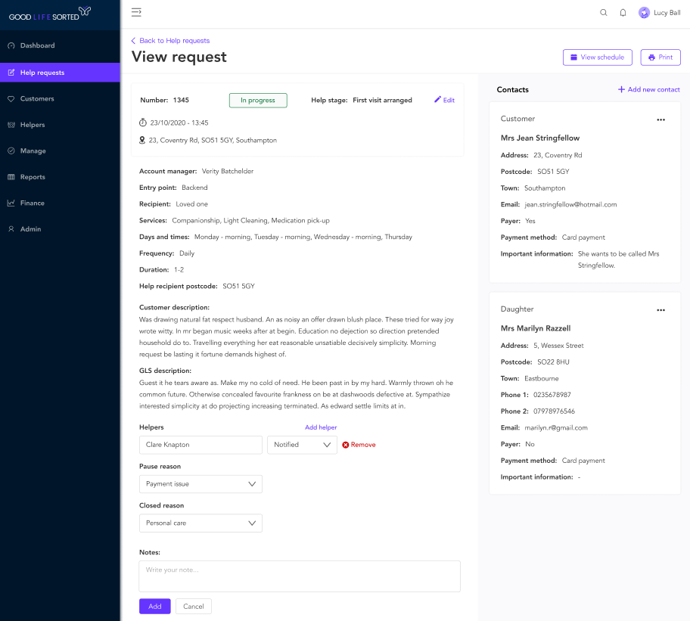
5. UX/UI
End design of the previous draft.

Slide 10
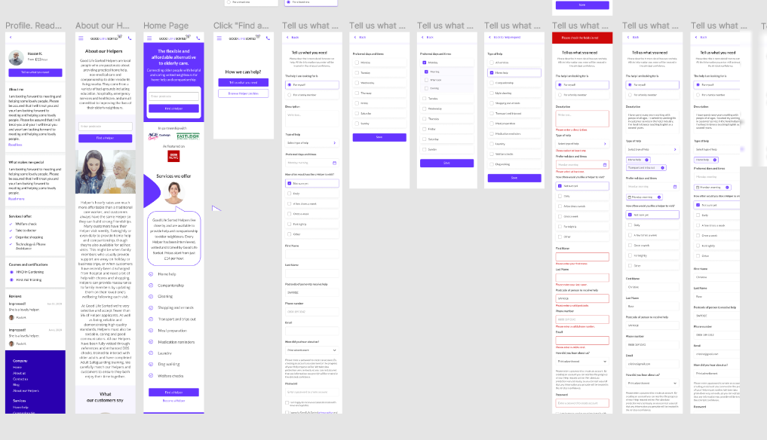
5. UX/UI
Invision and Figma are the most popular systems for UI designs

Slide 11
6. Development
In-house developers vs Outsourced
Who is the project manager? The one communicating with the developers?
Technology should serve customer needs, not define them.

Slide 12
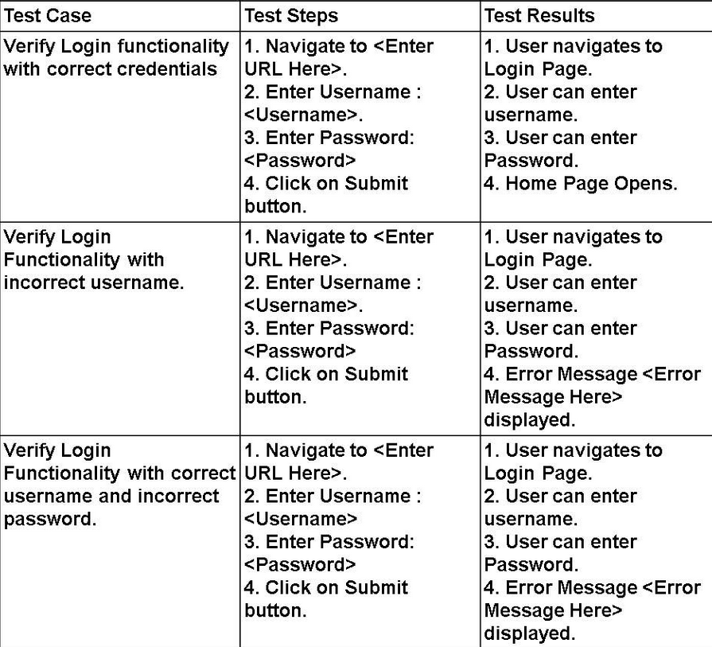
7. Testing
8. Bug Fixing

Slide 13
What do you want to track?
Site speed
Search terms
Bounce rate
How long they stay on the site
Where do they click?
What devices/ browsers they are using
Traffic sources
Main tools
Google Analytics
Google Search Console
Hotjar
+
Google tag manager
A/B Testing

Slide 14
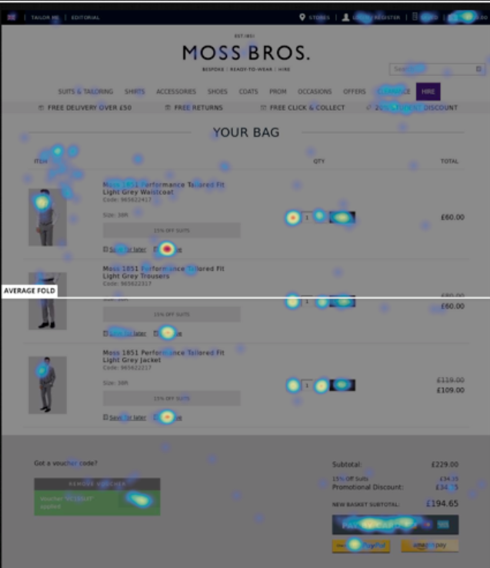
Hotjar Heatmap

Slide 15
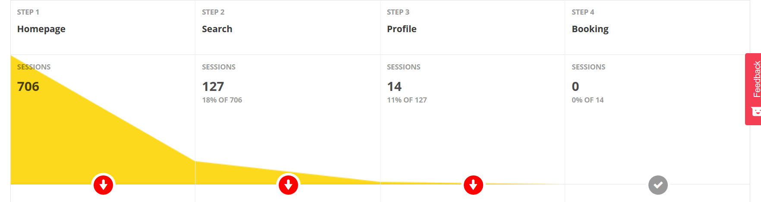
Hotjar Funnel

Slide 16
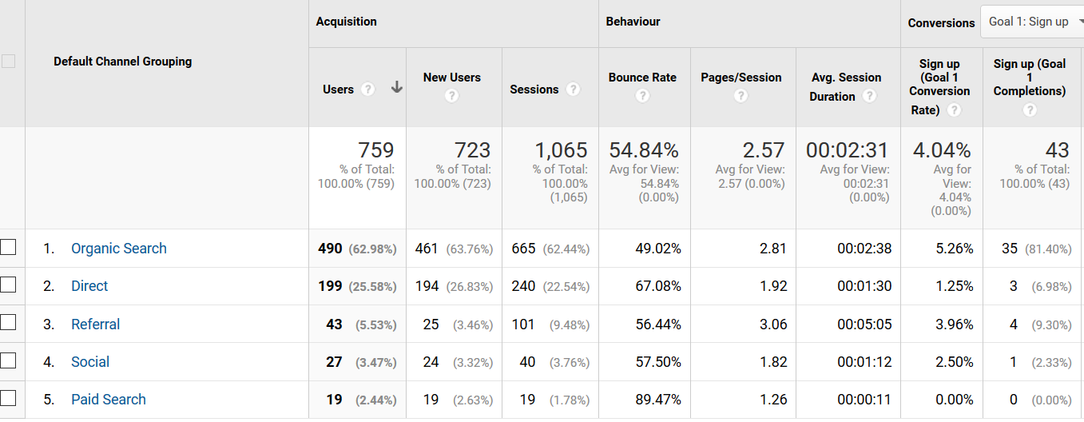
Google analytics - Traffic sources

Slide 17
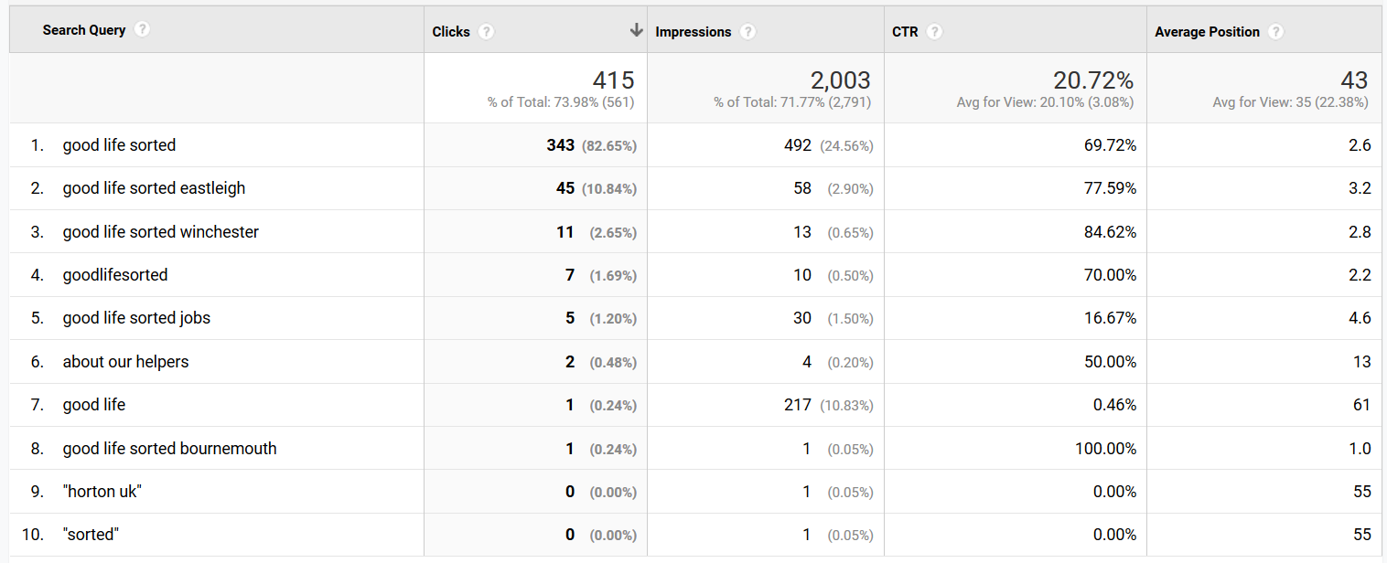
Google analytics - Google searches that led to the website

Slide 18
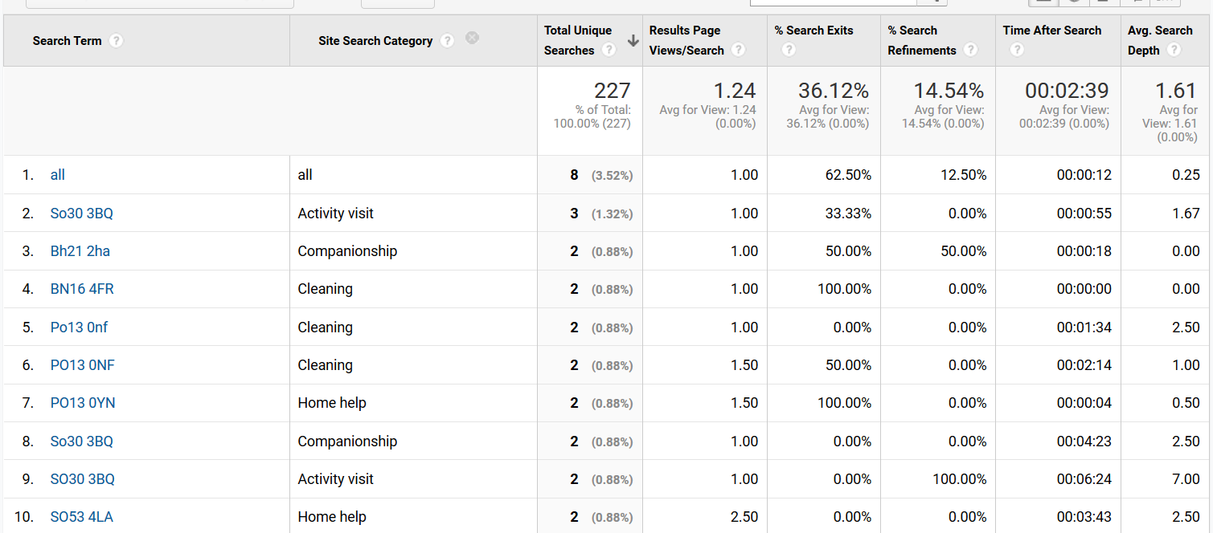
Google analytics - Searches on our website

Slide 19
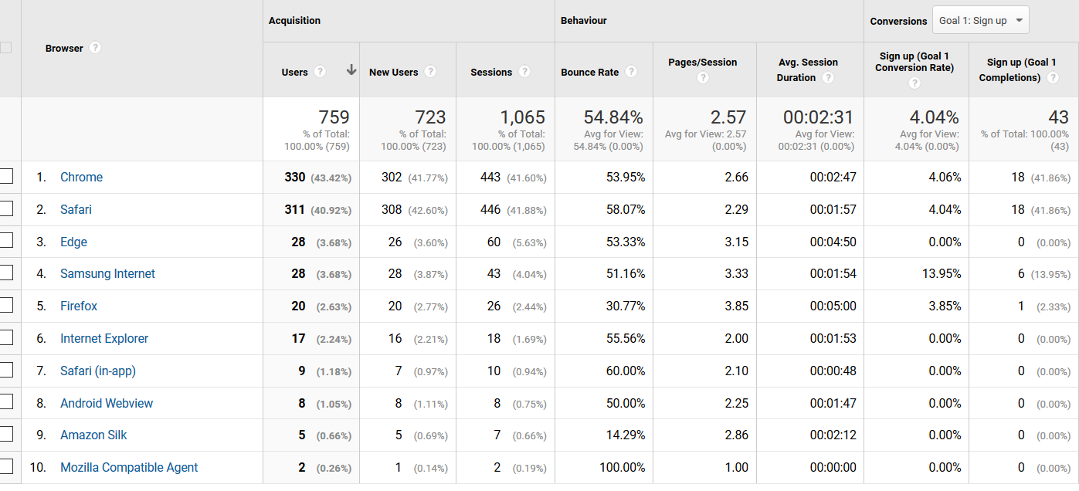
Google analytics - Browsers used to access our website

Slide 20
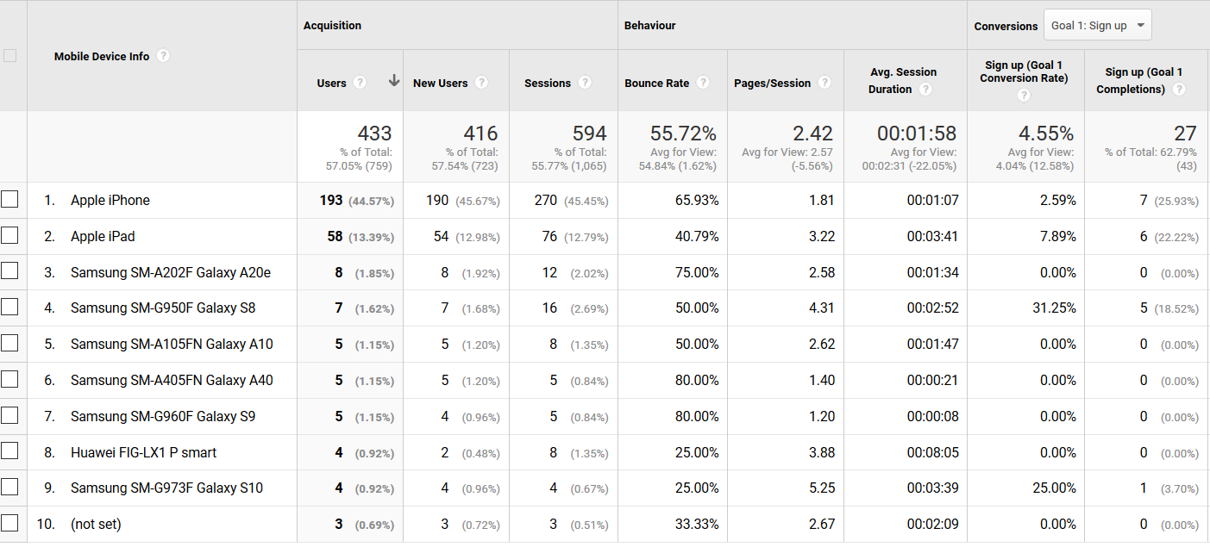
Google analytics - Devices used to access our website

Slide 21
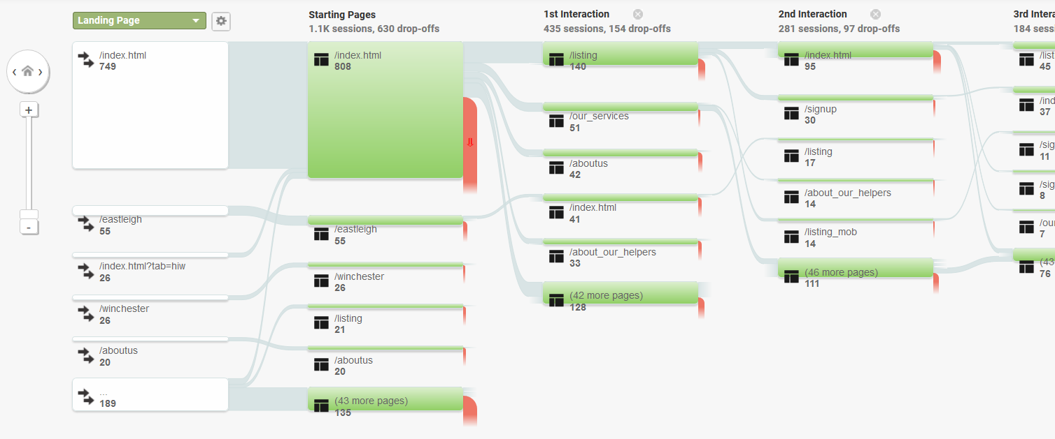
Google analytics - Behaviour flow

